Slide 1
Cloudy with a chance of IaaS
Ronny de Jong
Stijn Callebaut

Slide 2
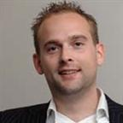


Ronny de Jong
Consultant & Trainer Inovativ NL
Stijn Callebaut
Consultant
Inovativ BE
Notes:
Stijn & Ronny

Slide 3
Session objectives
Introduction
Overview of the provisioning portals
Review the Microsoft solution set
Better together – System Center 2012 R2
Future
Notes:
Ronny
Introductie – Microsoft Cloud OS visie
Overview – Provisioning Portal target public/private clouds
Toekomst Service Management Automation PowerShell Workflows

Slide 4
Introduction

Slide 5
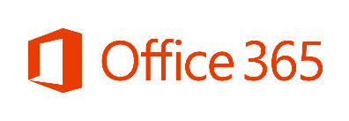



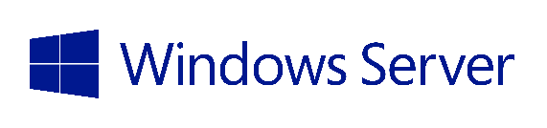
Microsoft Coud OS vision
Public Cloud
Azure Virtual Machines
1
Consistent
Platform
Private Cloud
Service Providers
DEVELOPMENT
MANAGEMENT
DATA
IDENTITY
VIRTUALIZATION
Notes:
Ronny

Slide 6





Cloud OS Principles
Common User Experience
Cloud Optimized Services
Consistent
APIs
Common Toolsets
Available to Partners
Cloud OS – Hybrid Cloud Architecture
Workload Mobility
PUBLIC
PRIVATE
HOSTED
Notes:
Ronny
Cloud Principles – elastic – usage based – pooled resources -

Slide 7

One Consistent Platform
Flexible development
Unified dev-ops and mgmt
Common identity and security
Integrated virtualization
Complete data platform
MICROSOFT
Azure
1
ON-PREMISES
Cloud OS
SERVICE
PROVIDER
Notes:
Ronny
Wat houdt dit in?
Test/Acceptatie/Productie hetzelfde platform
Gemeenschappelijk beheerlaag System Center
Dezelfde hyper-visor (Hyper-V 2012)

Slide 8
Provisioning portals
Notes:
Stijn

Slide 9
VM Cloud Provisioning Landscape
App Controller
Common experience across public and private clouds
Platform as a Service application
Windows Azure Portal
“One Stop Shop” for Cloud Services and Management
Target Azure public cloud
Windows Azure Pack
Rich IaaS experience for self-service provisioning of Virtual Machines hosted on Windows Server and System Center 2012
System Center Orchestrator
Runbook automation
Notes:
Stijn

Slide 10
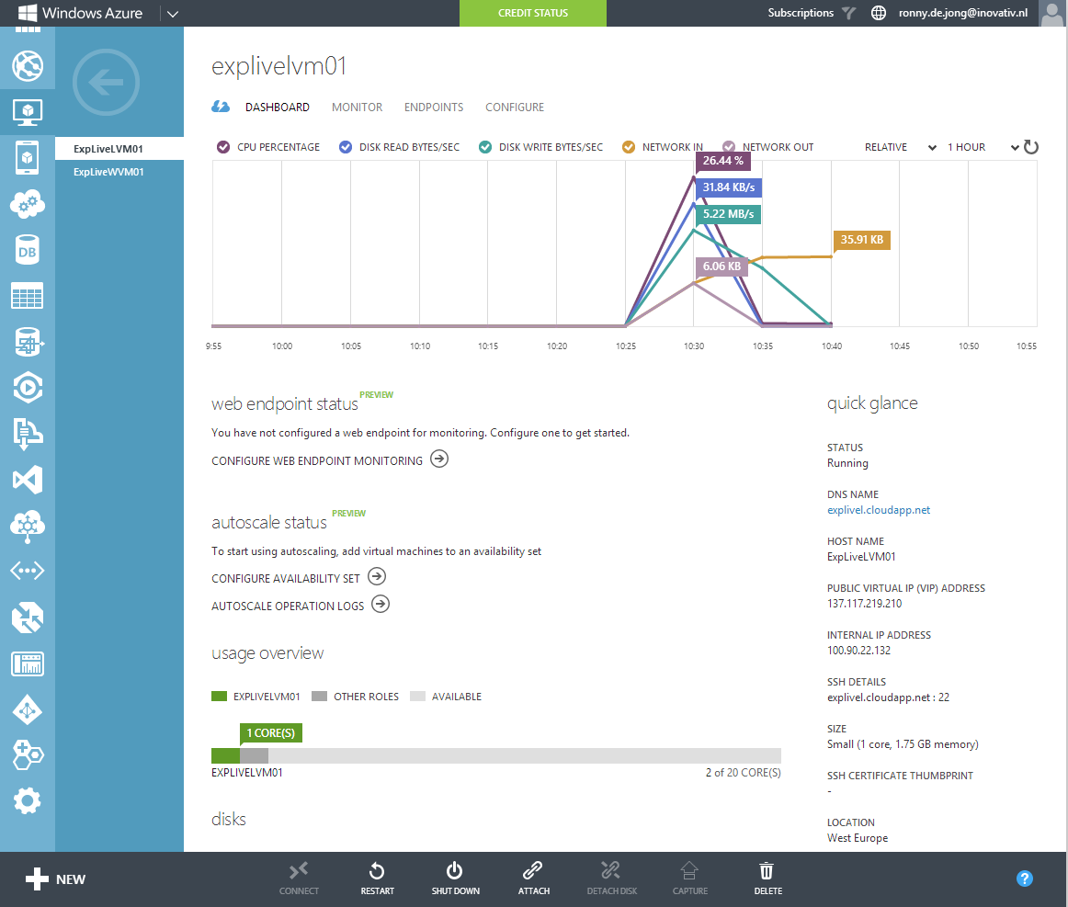
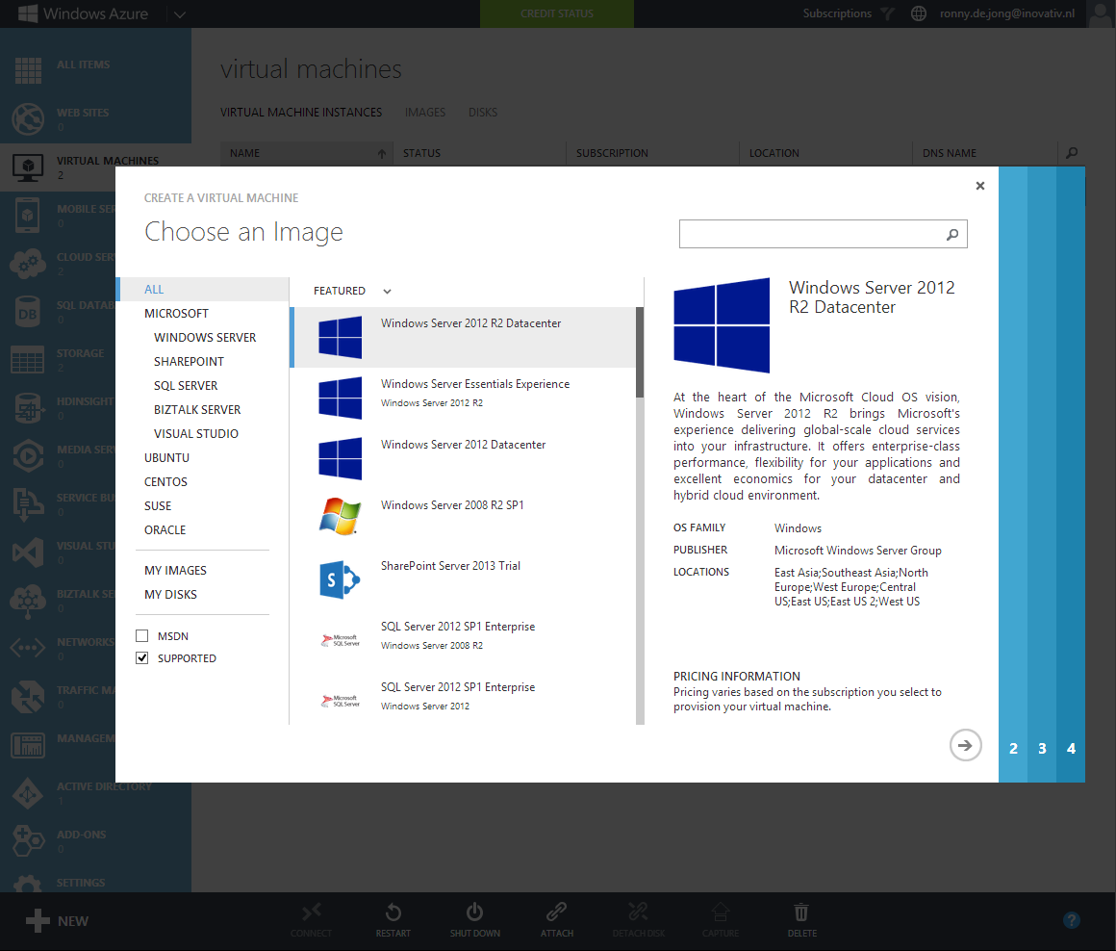
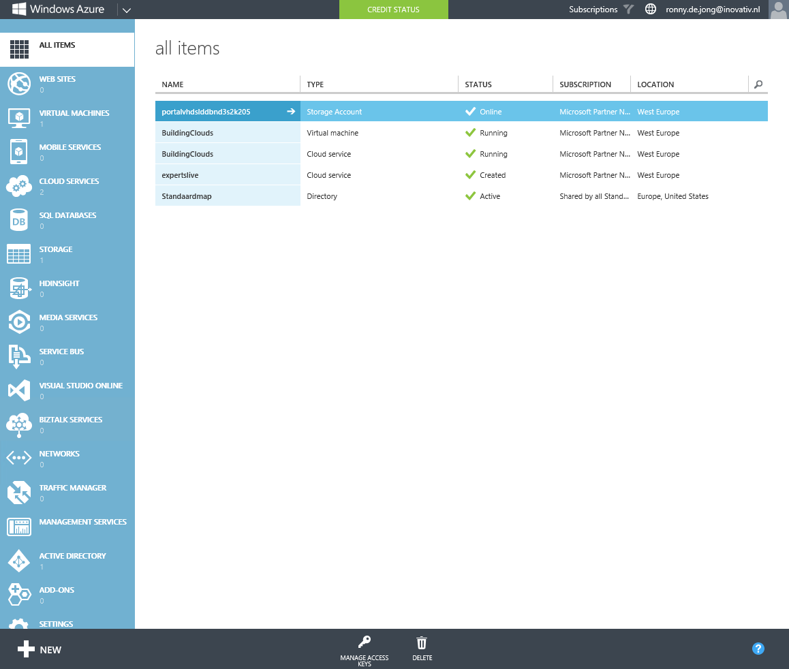
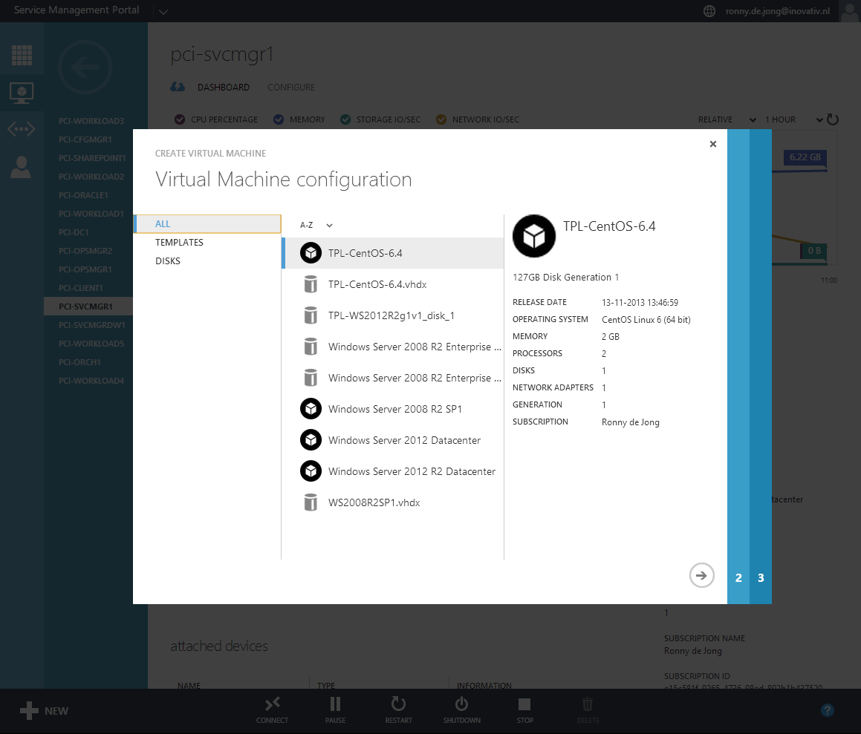
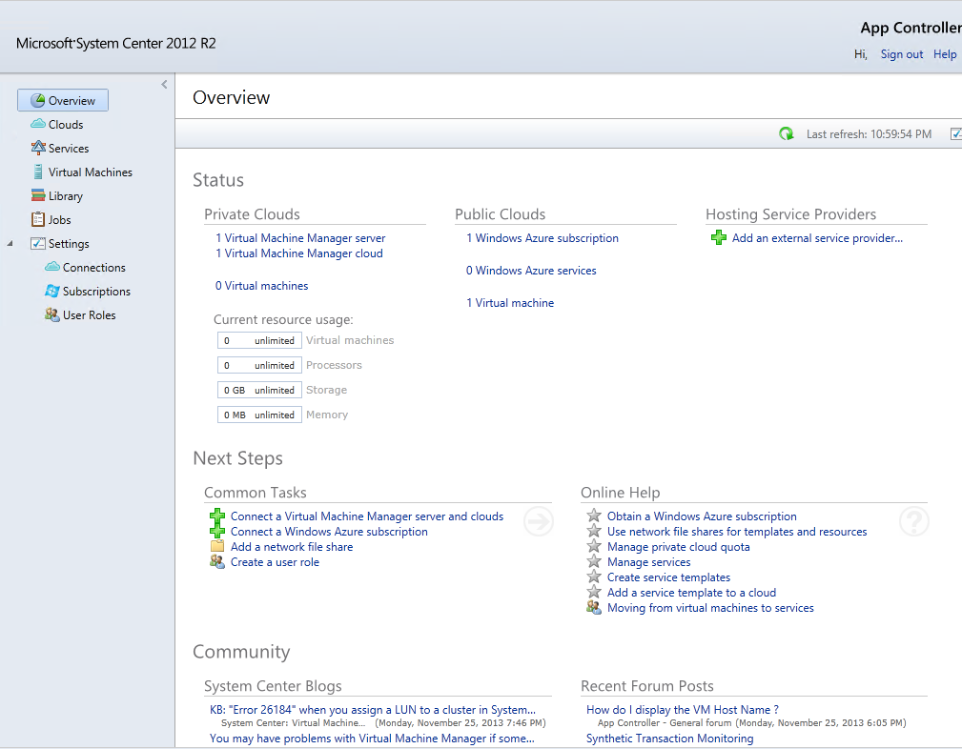
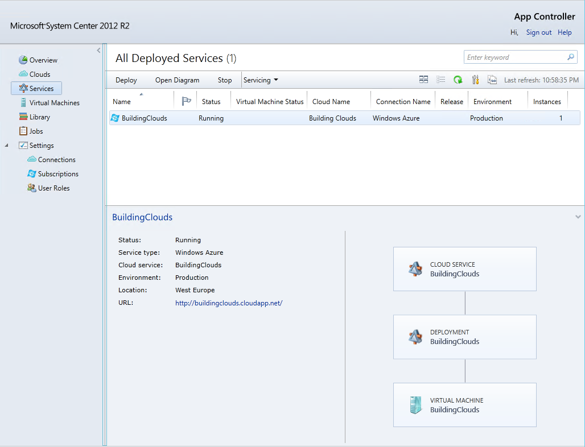
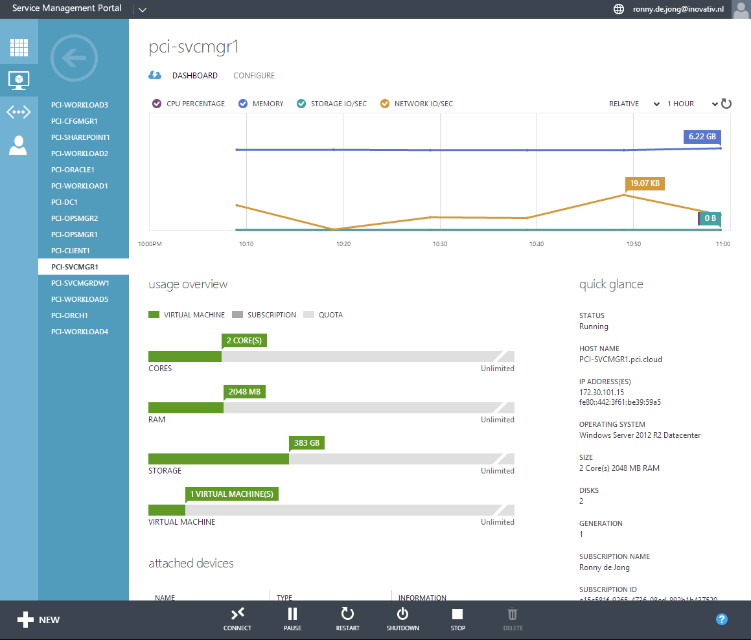
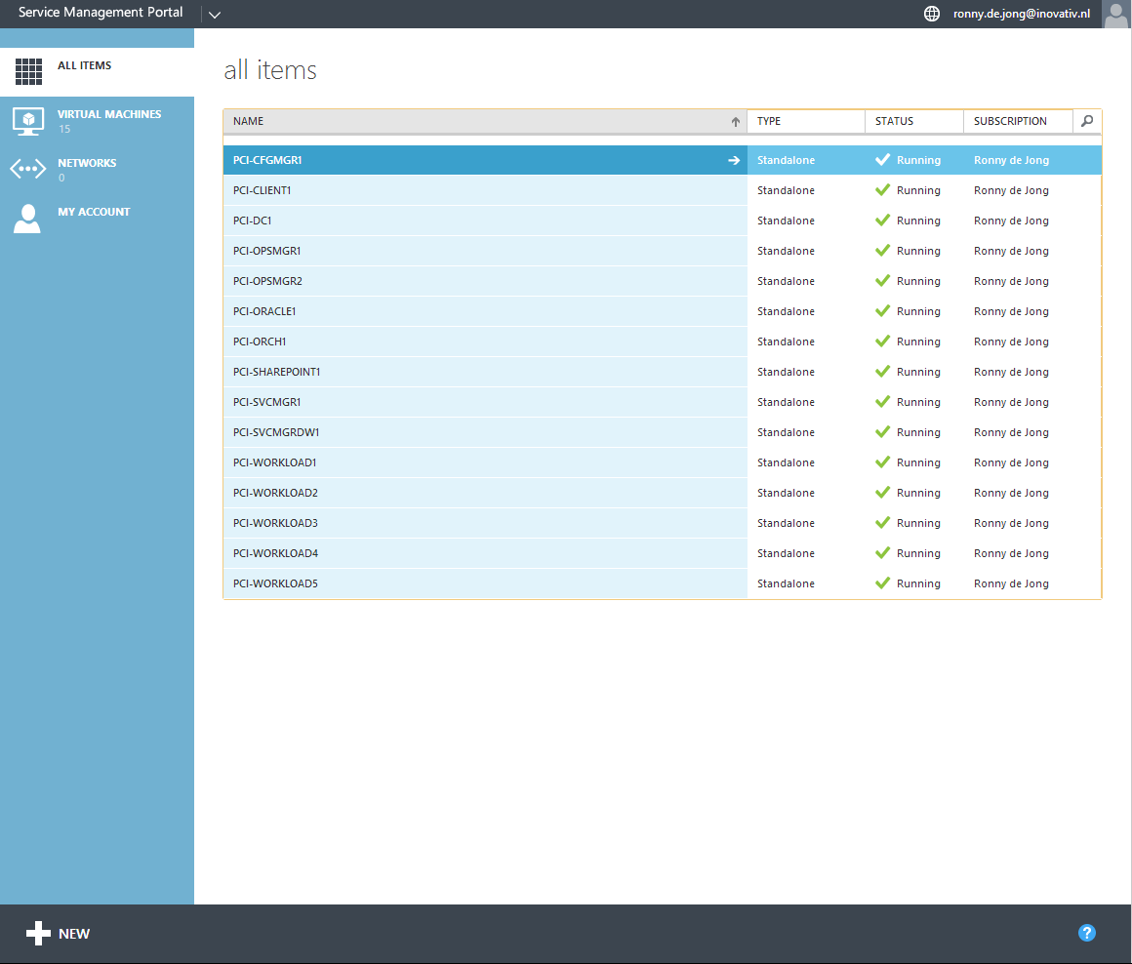
Portals Overview
Windows Azure Pack
App Controller
Windows Azure
Notes:
Stijn
App Controller
Windows Azure Pack
Windows Azure

Slide 11
Challenges

Slide 12
Problem Statement
Consistent platform, but each has its own target cloud.
No Process integration in the request to create new VM’s
Deployment too many steps? Too many clicks?
Notes:
Stijn

Slide 13
Better Together!
Notes:
Ronny

Slide 14
Example Scenario
We take Service Manager into the environment
Service request in SCSM to request VM
Based on selected type of VM (Test/Production) target cloud is selected.
Approval is required before provisioning of the VM(s)
Both public (Azure) and private cloud (SCVMM) requests via one portal.
Follow-up of the request must be possible via portal
Notes:
Ronny

Slide 15
Demo Better Together!
Notes:
Ronny – provisioning
Vm – azure
Vm – vmm

Slide 16
Windows Azure + Orchestrator + SCSM + SCVMM
Better Together
Removes much of the complexity of managing Windows Azure features & resources
Removes cloud selection via predefined policies
Service Request Process integration. Ability to integrate approvals and record all requests history.
Automated Deployment
Go from a “record” in a database – To Cloud Services Virtual Machine Deployment
Based on input provided the requested VM is provisioned to Azure or SCVMM
Automated Deprovisioning
Worried about leaving resources deployed/running?
Worry no more! Automated deprovisioning of resources is one click away!
Notes:
Stijn

Slide 17
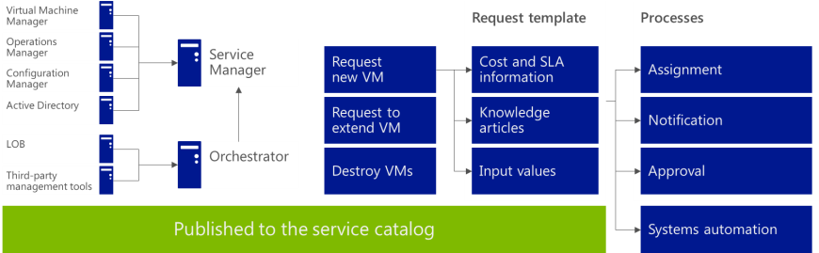
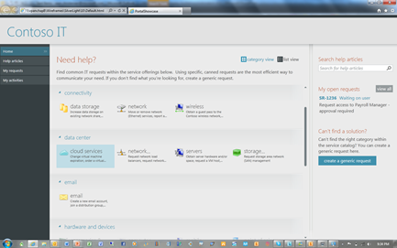
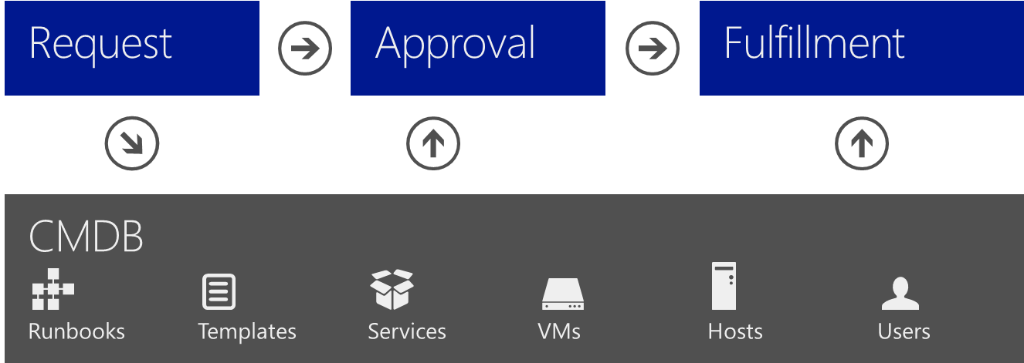
Deploy service delivery and automation
Standardization
Self-service
Automation
Standardize the services provided by IT to consumers
Define the services to be offered
Define the request offerings that will be contained within a service offering
Identify who needs to be involved (approvals, notifications, fulfillment)
Give consumers of IT services the ability to identify, access, and request services as needed
Controlled empowerment
Request offerings displayed based on user role
Intuitive, easy-to-navigate portal
Automate the service processes and systems necessary to the fulfillment of consumer requests
Automate routing of requests for approval and notification
Automate provisioning of the service request
Notes:
Stijn

Slide 18
Proactive processes
Event mgmt
Close
request
Benefits
Improved SLA support
Supports compliance
Process traceability
Improved productivity
Captures best practices
Improved operational ROI
Service desk
Monitor
for error
Update
CMDB
Asset/CMDB
Initiate
change
Associate server to service
Configuration
Create
deployment
Standard operating procedures
Disaster recovery procedures
Virtual
Change and compliance
VM to
maintenance
Provisioning
Security
Storage
Create
extra disk
Connect
disk to VM
Server
Update
server
Network
Configure
network
Notes:
Stijn

Slide 19
Orchestrator Automation
Microsoft and 3rd party support
Microsoft IPs
Operations Manager
Virtual Machine Manager
Data Protection Manager
Service Manager
Configuration Manager
Active Directory
In Box IPs
System
Scheduling
File Management
Text File Management
Email
Utilities
3rd Party Support
VMware vSphere 4.1 and 5
IBM Netcool 7.3
HP Operations Manager 9.x on platforms supported by HP web services
HP Service Manager 7.11 and 9.x on platforms supported by HP web services.
HP iLO & OA supporting iLO2 and iLO3 and OA firmware 3.21
Exchange (User/Admin)
Sample community IPs on Codeplex:
Team Foundation Server
PowerShell
SharePoint
Active Directory
Configuration Manager 2007
Exchange Mail and Exchange Calendaring
Local Security
Scheduled Tasks
Utilities
VMWare
F5
Notes:
Stijn

Slide 20
Better Together! Solution overview
Notes:
Ronny -

Slide 21
Demo Components overview
Notes:
Ronny – SCSM (Connector, CI, Service Request, RBA)
Stijn - SCORCH

Slide 22
More possible scenarios…
Move service from On-Prem to the Public Cloud
Runbooks to backup or move VMs away from On-Prem resources to Cloud Resources
Move service from the Public Cloud to On-Prem
Runbooks to download VMs from the Cloud to On-Prem resources
From Windows Azure to the rest of System Center 2012 SP1
The Public Cloud is just a few simple steps from On-Prem Management
Runbooks connecting Operations Manager, Service Manager, Virtual Machine Manager and Configuration Manager
Test lab provisioning
Imagine, single click and you deploy a complete lab environment.
Automated scale-in and scale-out scenarios
Notes:
Ronny

Slide 23
More possible scenarios…
Each cloud solution has its own provisioning portal.
With System Center you can have a unified way to target both
Quick start: 21 Azure Example Runbooks Available (with Video Demonstration)! http://blogs.technet.com/b/building_clouds/archive/2013/02/22/automation-orchestrating-windows-azure-solving-the-public-cloud-puzzle-with-system-center-2012-sp1.aspx
Integrate human & system processes
Service Manager for human processes
Orchestrator for system automation
Notes:
Ronny

Slide 24
What’s next?
Notes:
Stijn

Slide 25
What is SMA ?
Run and manage Runbooks to integrate, orchestrate, and automate IT business processes.
Set of tools that is integrated as the Automation extension in Windows Azure Pack.
Runbooks run on the Windows PowerShell workflow engine.
Notes:
Stijn

Slide 26








Service Management Automation Capabilities
Web based Runbook Authoring:
Service Administrator can create runbooks to automate all aspects of cloud infrastructure, plan delivery, and maintenance activities
Highly Available Engine
Support requirements for scale and H/A.
Built on PowerShell Workflow
Integration into other systems:
Import PS modules and create additional modules and runbooks for existing resources or to connect into 3rd party systems (ticketing system, billing system, user store, CMDB)
All
ITEMS
WEBSITE CLOUD
12
CMDB
VIRTUAL MACHINE CLOUDS
12
Automation
SQL SERVER
9
Add bulk user accounts
Service Ticket for failed resources
Notify users of plan updates
Add additional SQL capacity
Ticketing
MYSQL SERVERS
0
Notifications
0
PLANS
12
Billing
USER ACCOUNTS
4
AUTOMATION
8
Management
Systems
Notes:
Stijn

Slide 27
Should I use Orchestrator or SMA?
Orchestrator Runbooks
SMA Powershell workflows
Automate business processes and IT operations in your data center without scripting or programming.
You can also use PowerShell cmdlets to run other System Center 2012 components/Cmdlets.
Let you use integration packs that are not covered by PowerShell. (Example : Leveraging Service Manager)
“new future way” of building Runbooks based on PowerShell Workflow.
Automate processes within the Windows Azure Pack. (Runbooks for tenants / admins)
Runs Windows PowerShell workflows, you can also use PowerShell cmdlets to run other System Center 2012 components/Cmdlets.
Provides 64bit support with PowerShell workflow
Notes:
Ronny – waarom zo ik SMA gebruiken, Orchestrator, SMART
(gelijkwaardig oplossing, ondersteuning vanuit 3rd party leveranciers.

Slide 28
SMA & Orchestrator 2012 R2
PowerShell Authoring
Graphical Authoring
Interoperability
PowerShell Workflow Engine
UI Runbook Engine
Process Automation
Notes:
Ronny (gelijkwaardig oplossing, ondersteuning vanuit 3rd party leveranciers.

Slide 29
Q and A
Notes:
Stijn & Ronny

Slide 30

3 december – user group bijeenkomst HP Amstelveen Service Manager 2012 - Best Practices Performance & Process Automation Travis Wright en Chris Ross
Notes:
Ronny – SCSM (Connector, CI, Service Request, RBA)
Stijn - SCORCH

Slide 31
Volgende sessie 16:00 – 17:00
Keynote
Andre Kuipers

